Slide 1
Application Layer Functionality and Protocols

Slide 2
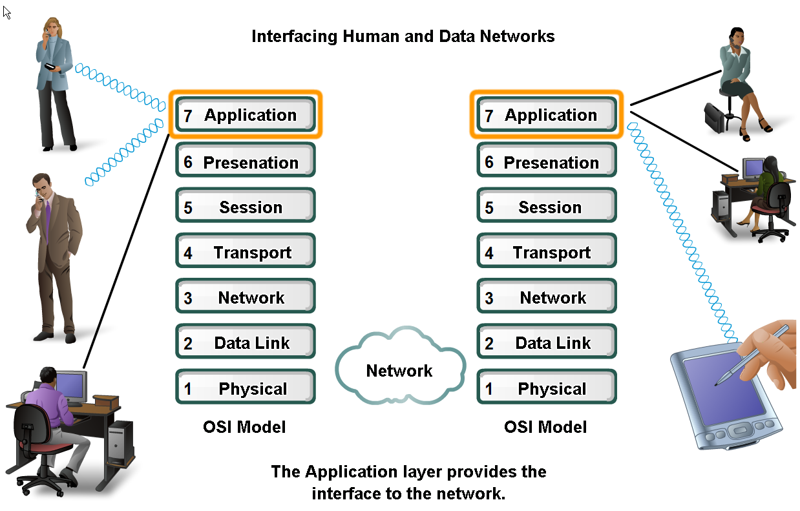
Applications
The Interface Between Human and Data Networks

Slide 3
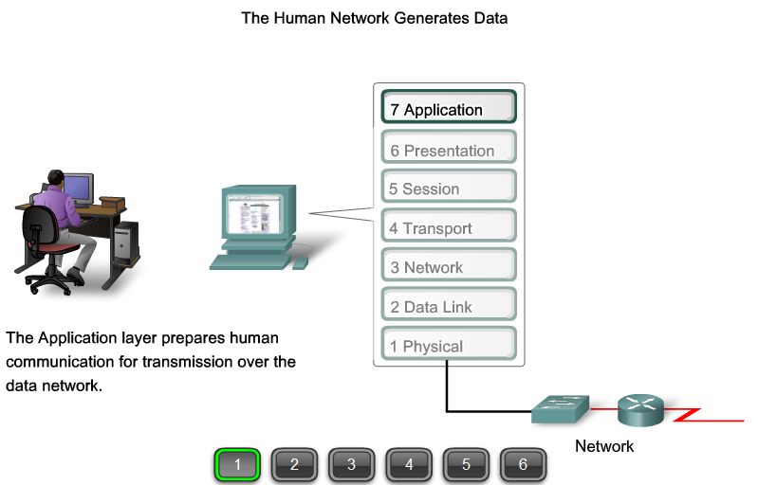
Applications

Slide 4
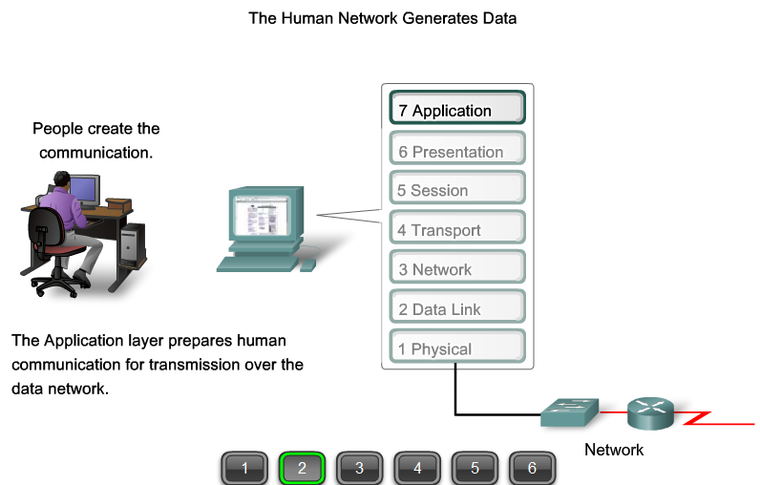
Applications

Slide 5
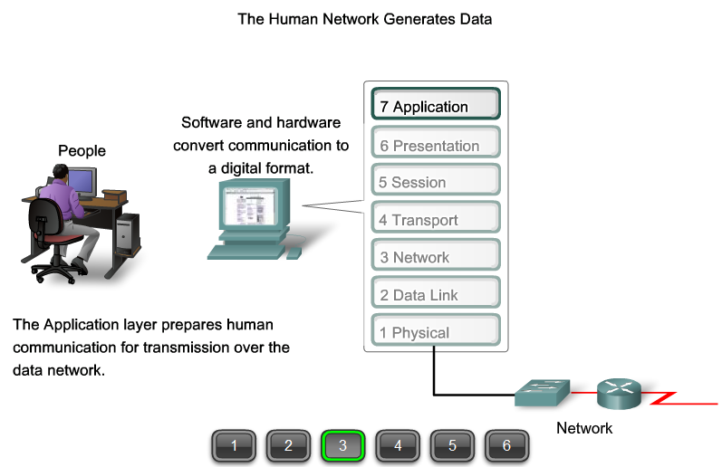
Applications

Slide 6
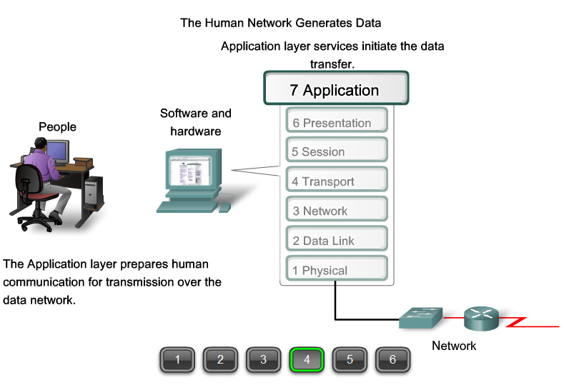
Applications

Slide 7
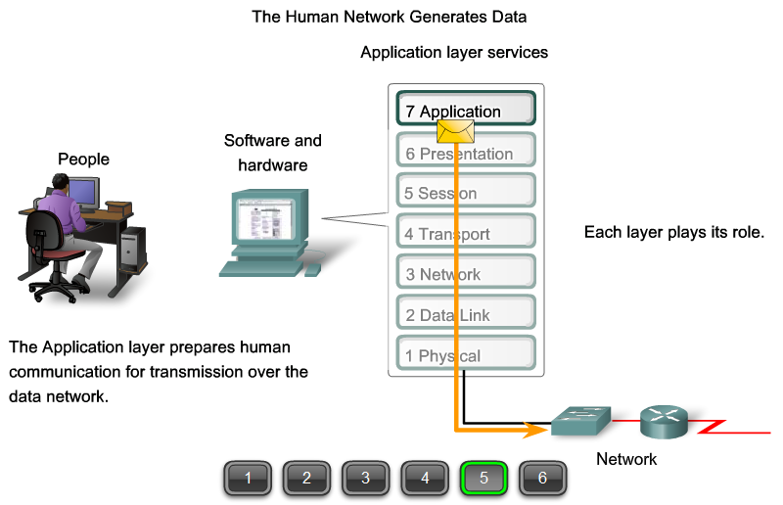
Applications

Slide 8
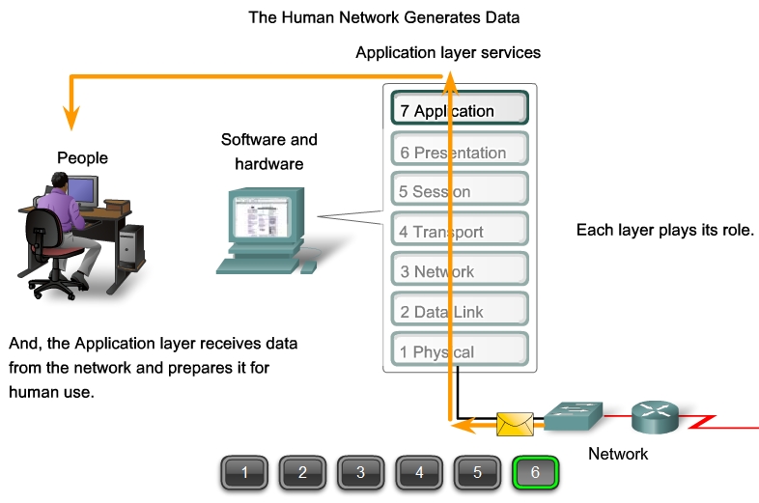
Applications

Slide 9
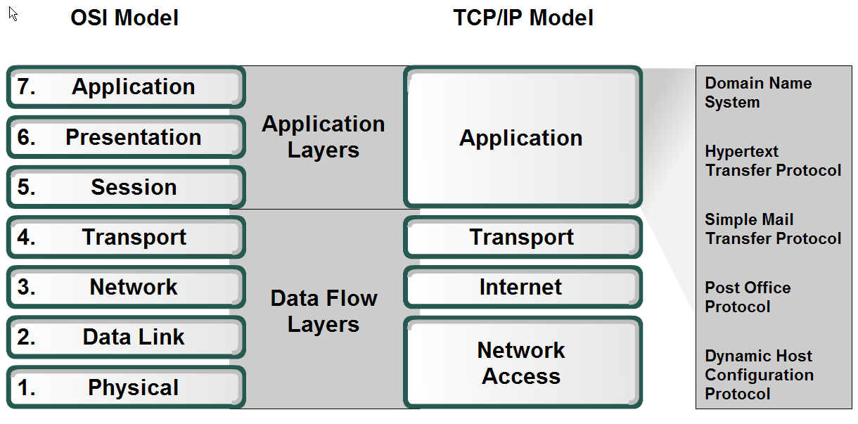
Applications

Slide 10
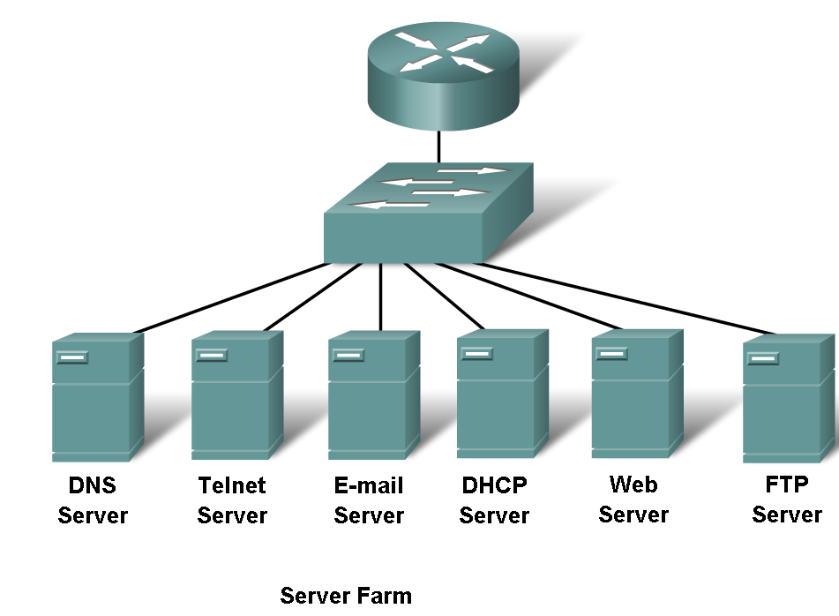
Server Farm

Slide 11
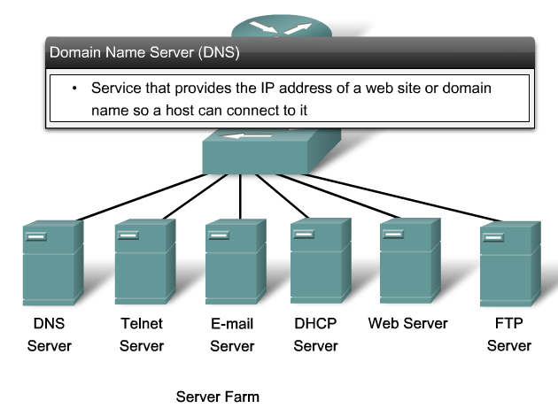
Server Farm

Slide 12
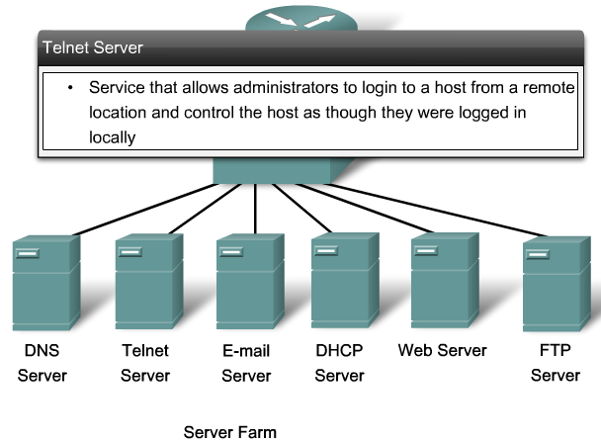
Server Farm

Slide 13
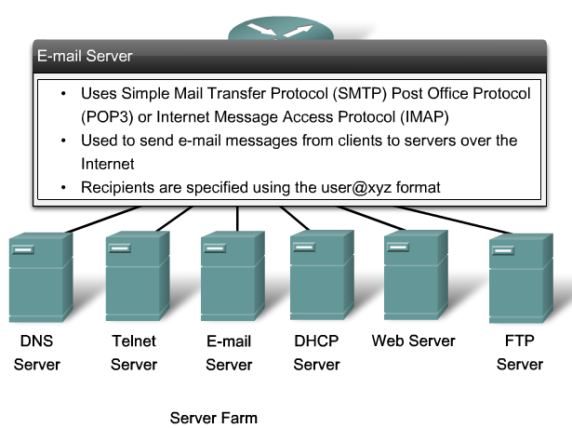
Server Farm

Slide 14
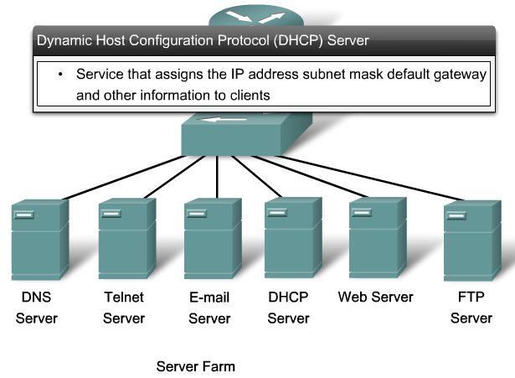
Server Farm

Slide 15
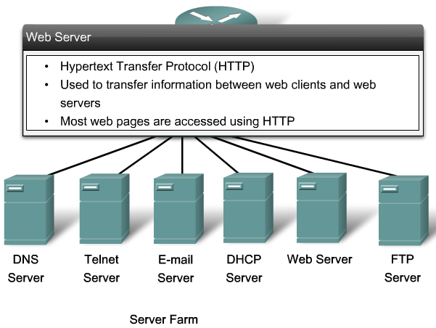
Server Farm

Slide 16
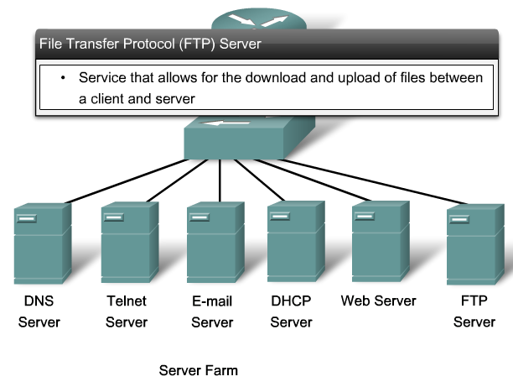
Server Farm

Slide 17
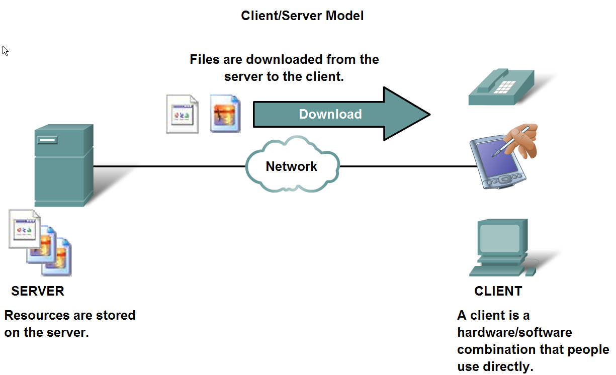
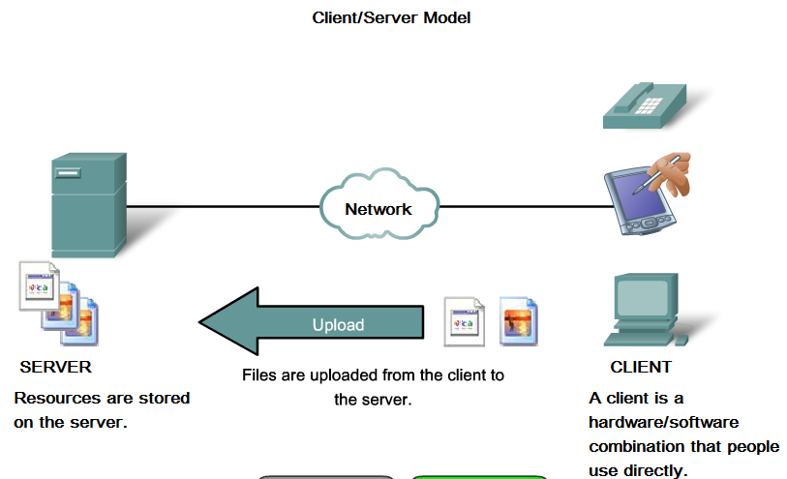
Client/Server Model

Slide 18
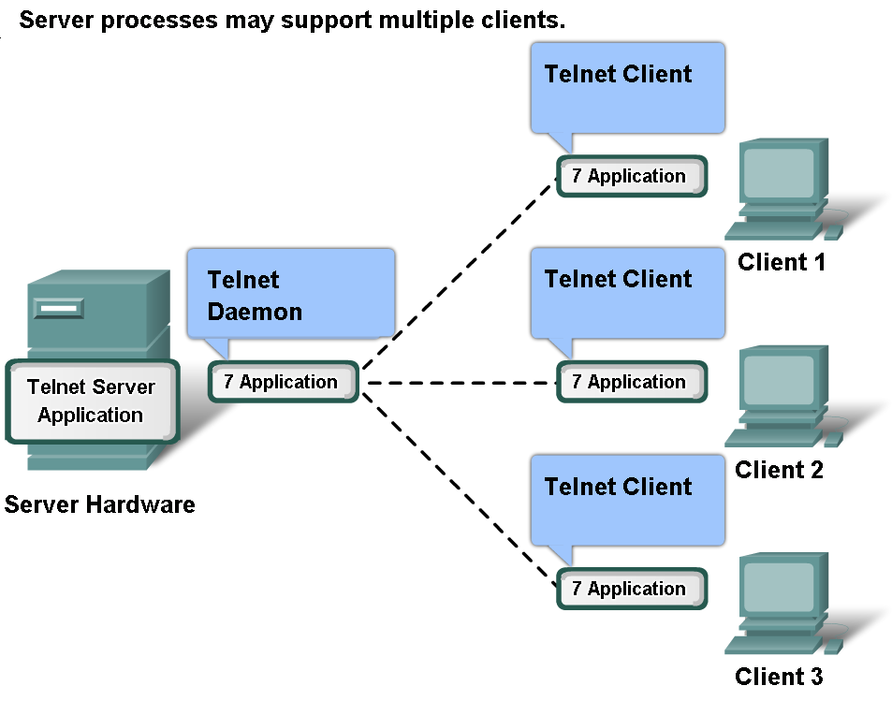
Client/Server Model

Slide 19
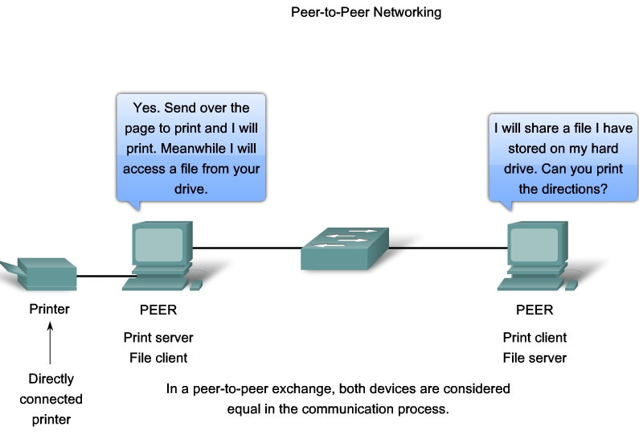
Peer to Peer Applications

Slide 20
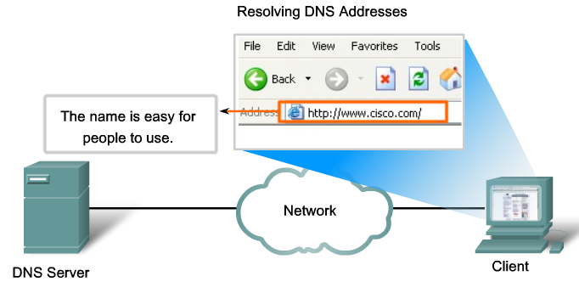
Domain Name Server DNS

Slide 21
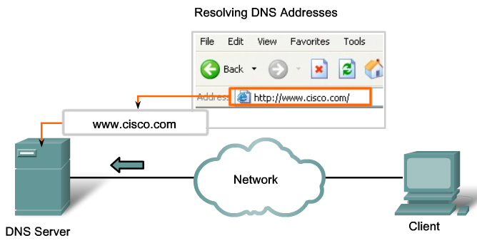
Domain Name Server DNS

Slide 22
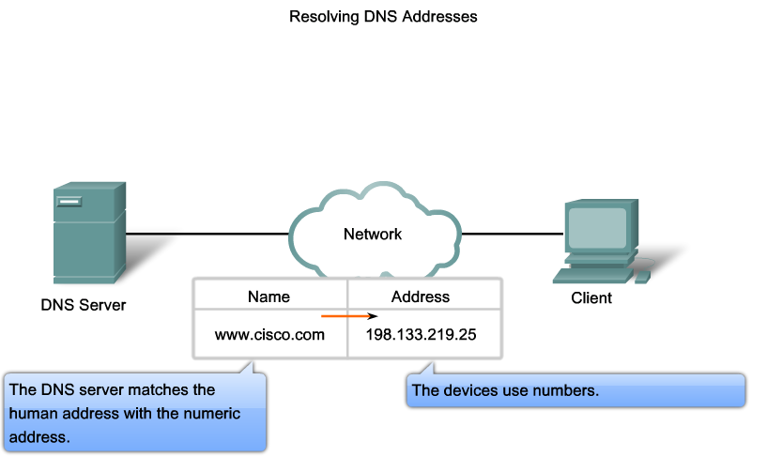
Domain Name Server DNS

Slide 23
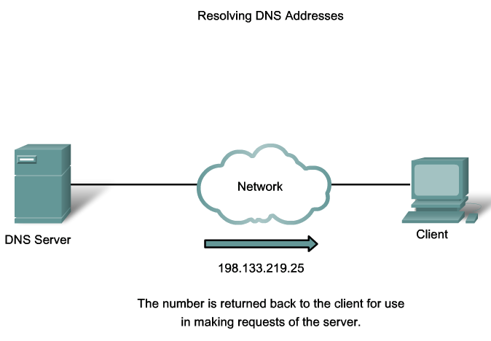
Domain Name Server DNS

Slide 24
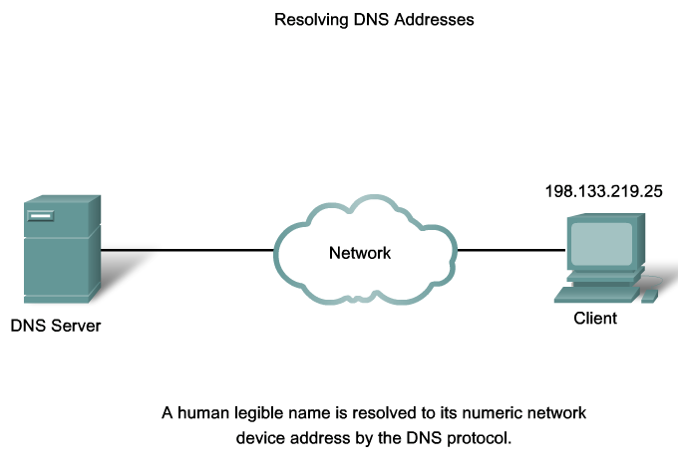
Domain Name Server DNS

Slide 25
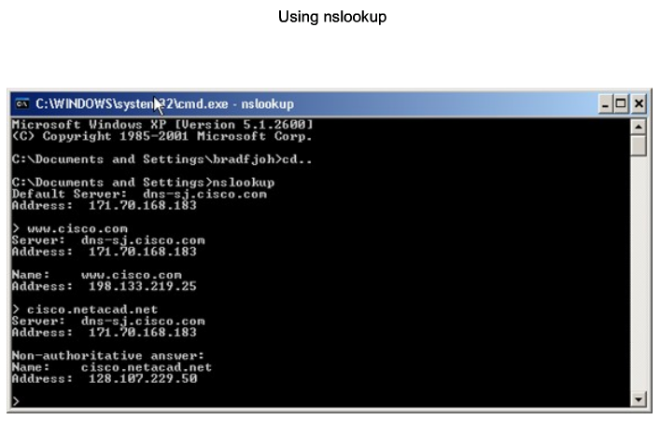
Domain Name Server DNS

Slide 26
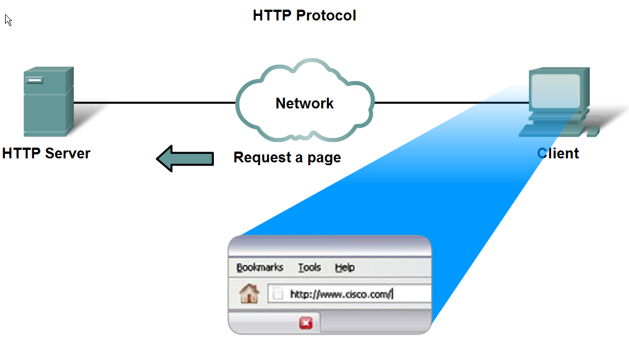
HyperText Transfere Protocol HTTP

Slide 27
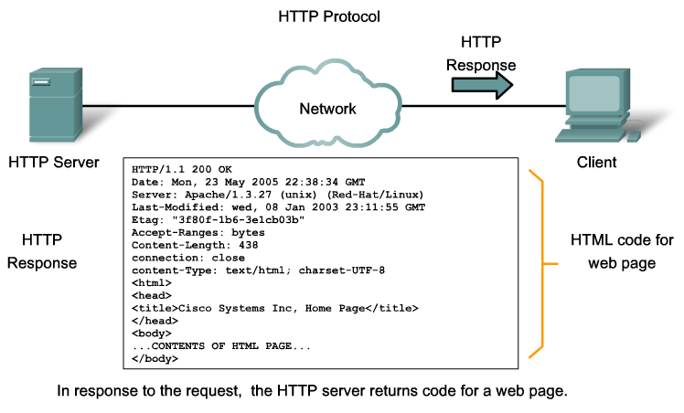
HyperText Transfere Protocol HTTP

Slide 28
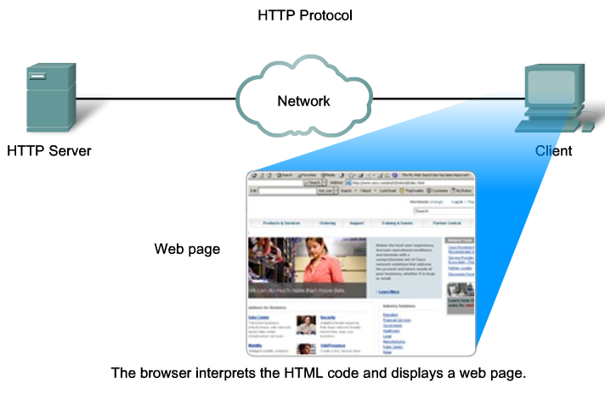
HyperText Transfere Protocol HTTP

Slide 29
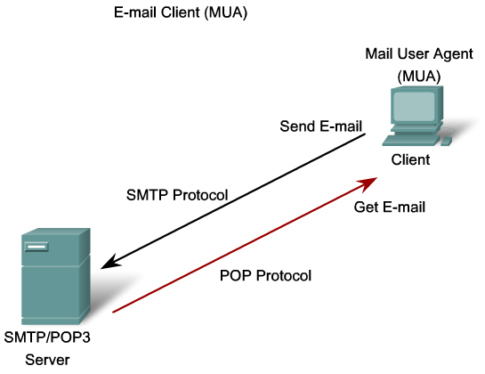
Post Office Protocol POP / Simple Mail Transfer Protocol SMTP

Slide 30
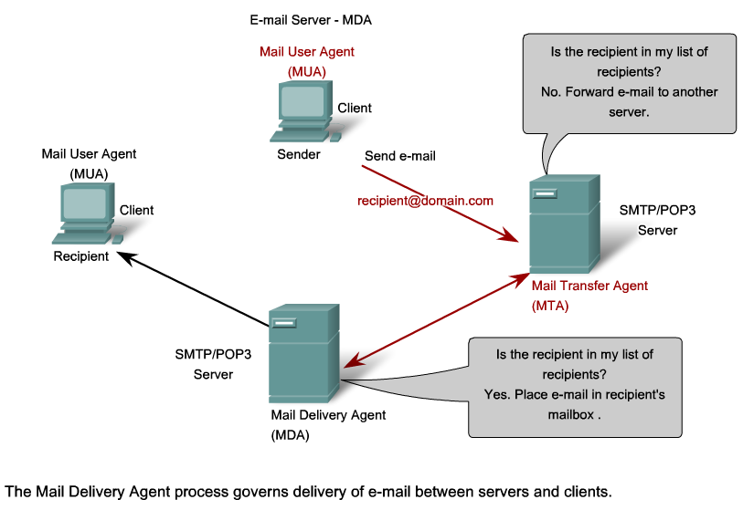
Post Office Protocol POP / Simple Mail Transfer Protocol SMTP

Slide 31
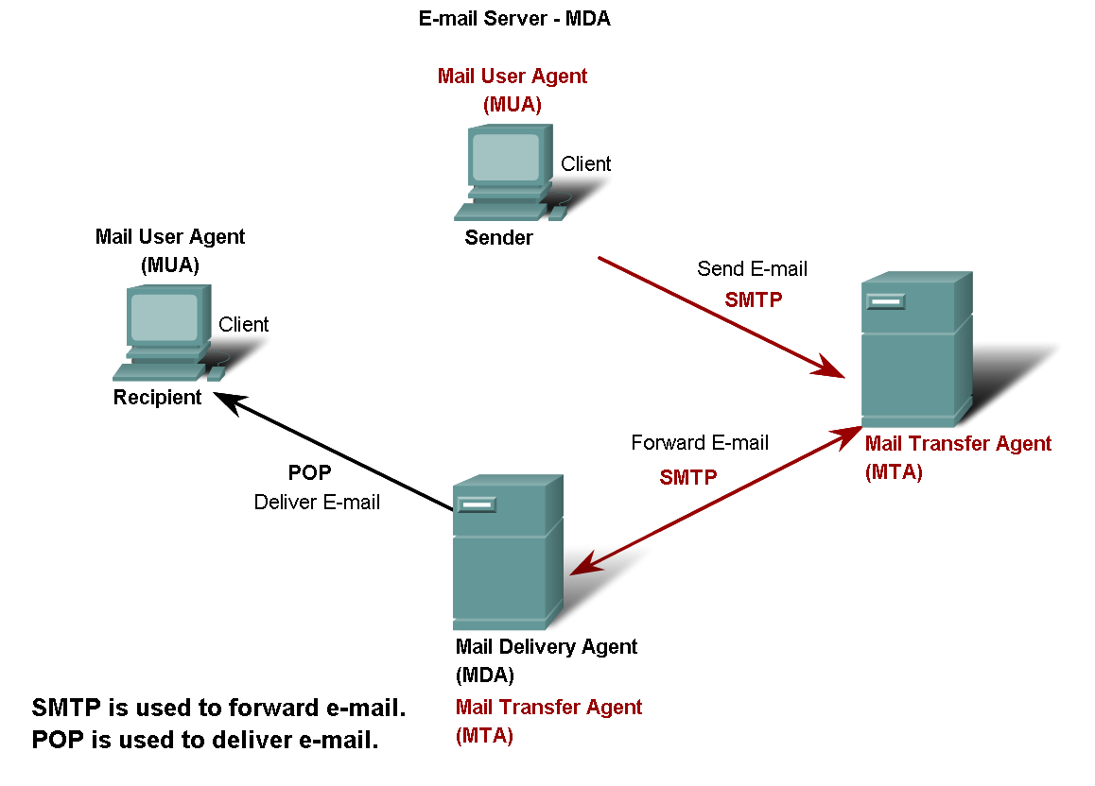
Post Office Protocol POP / Simple Mail Transfer Protocol SMTP

Slide 32
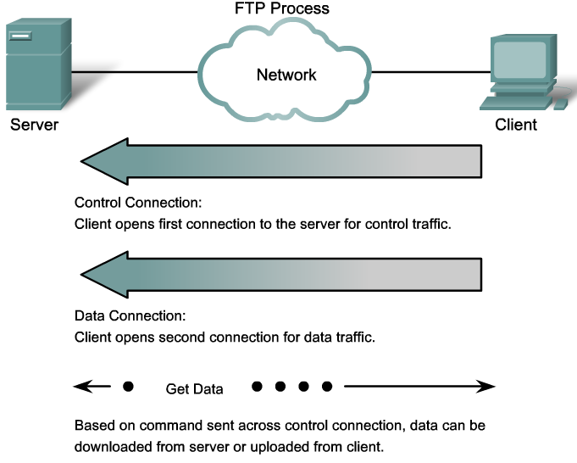
File Transfer Protocol FTP

Slide 33
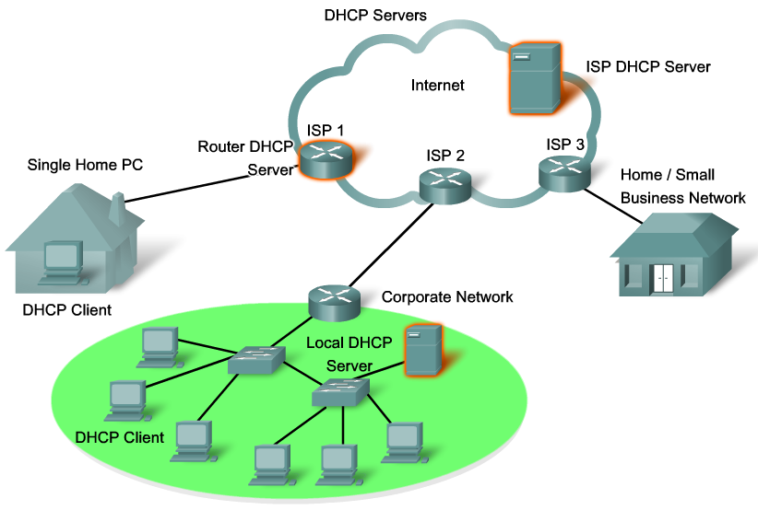
Dynamic Host Configuration Protocol DHCP

Slide 34
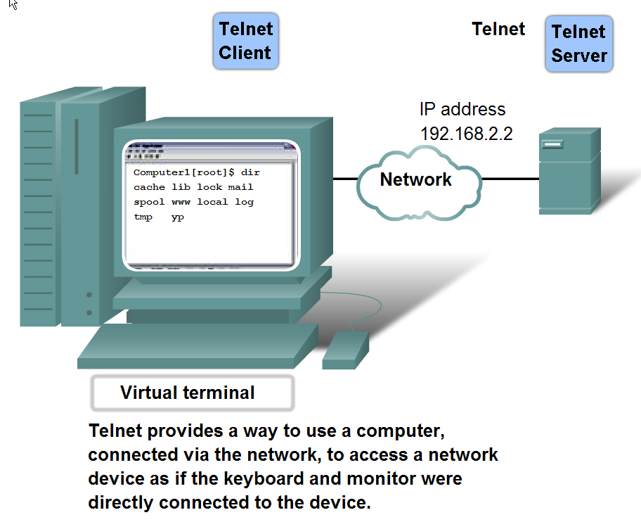
Telecommunication Network Telnet

Slide 35
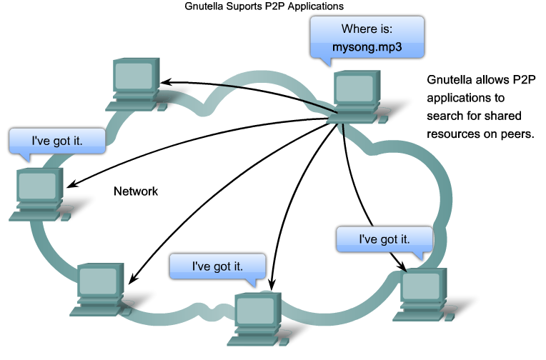
Peer-To-Peer Application P2P

Slide 36
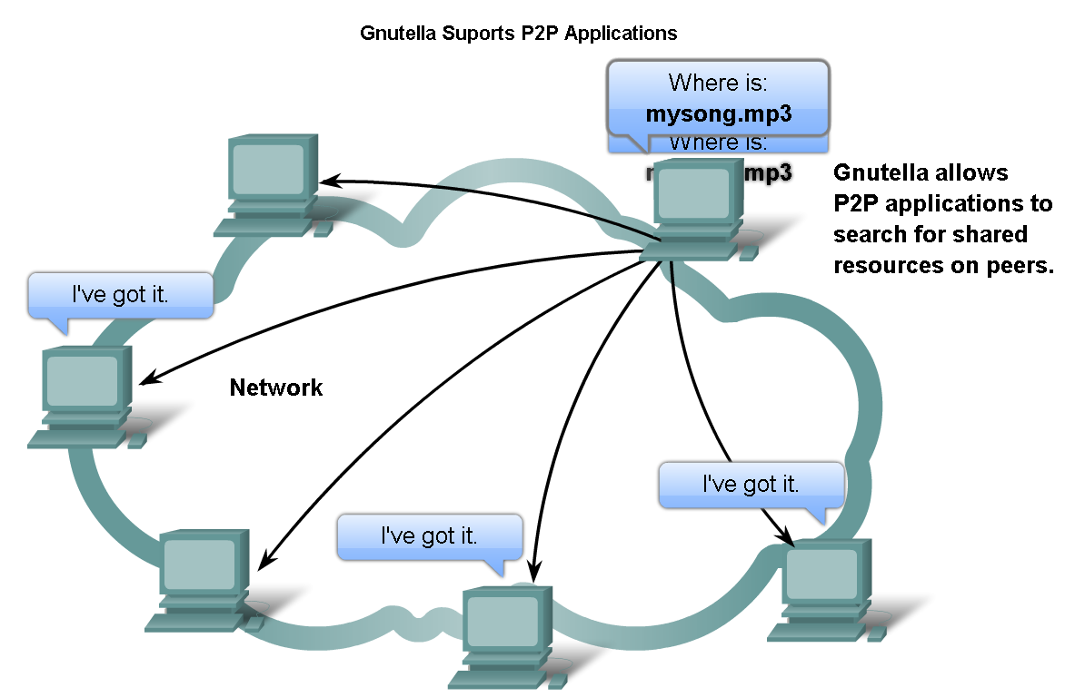
Features, Operation, and Use of TCP/IP Application Layer Services
Describe the features of the Gnutella protocol and the role it plays in supporting P2P services

